Slide 1
Vaccinations vs.
Influenza
Team 5: analyticus
Team Members:
Xiangyu Zhang
Daniel Ohriner
Yachen Yu
Patrick Humpphries

Slide 2
Agendas
Introduction
The Story Begins
Challenges and Lessons Learned
Geographic Perspective
Graphical Perspective
Questions and Answers

Slide 3
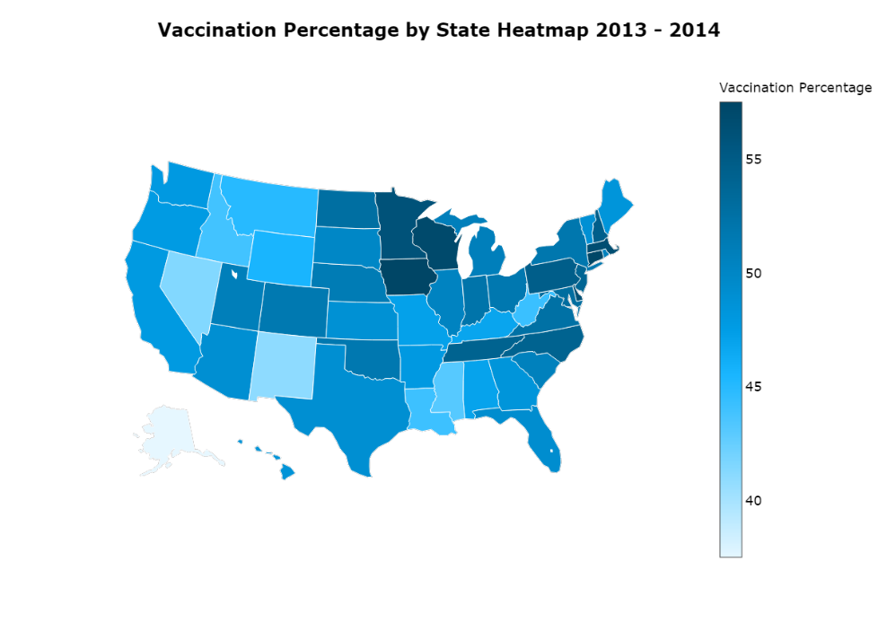
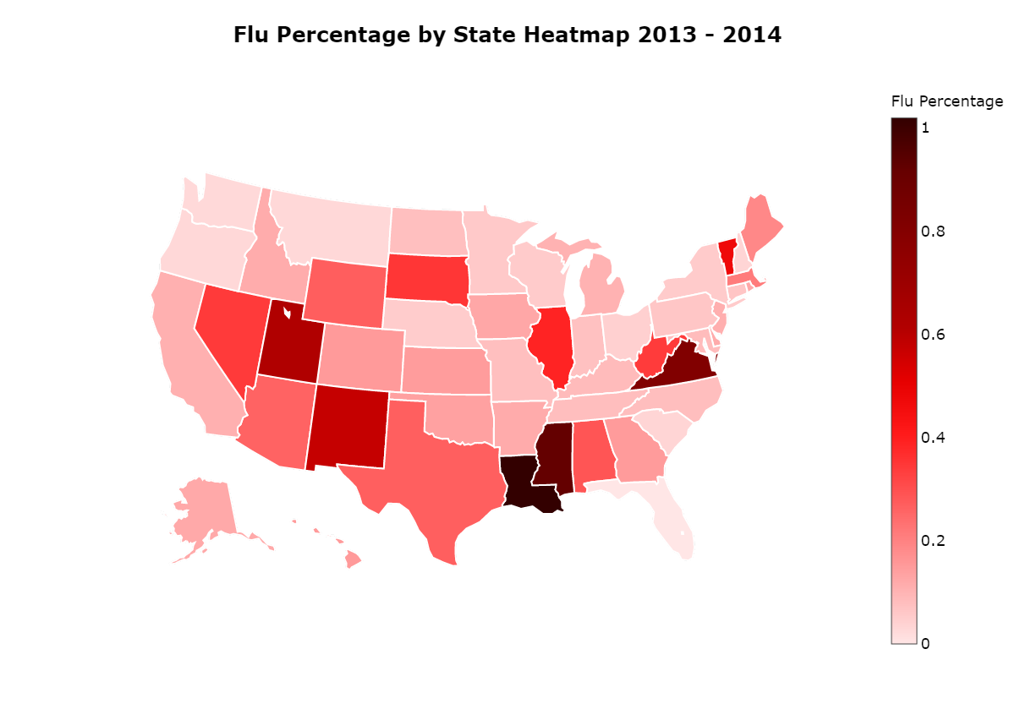
Vaccinations vs. Influenza
Generally, states higher vaccination rate would have lower influenza rate.
Notes:
Initial proposal: higher vaccination rate will lead to lower influenza rate.
Result: generally true in most of the 50 states (can tell by color):
Louisiana, Mississippi, new Mexico: low vaccination rate and high flu rate
Possible reason: educational level, cultural background leads to different belief.
Wisconsin, Iowa, Minnesota: high vaccination rate and low flu rate

Slide 4
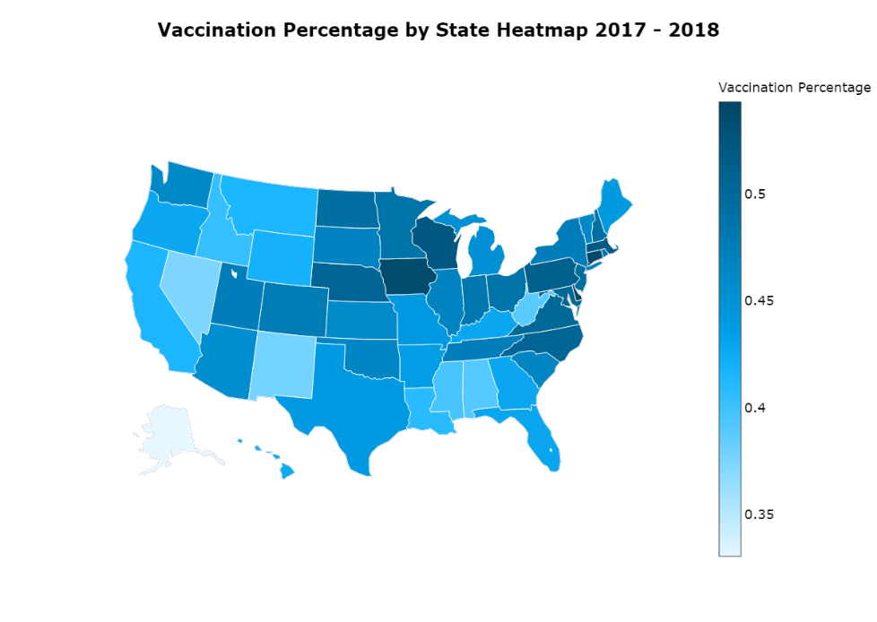
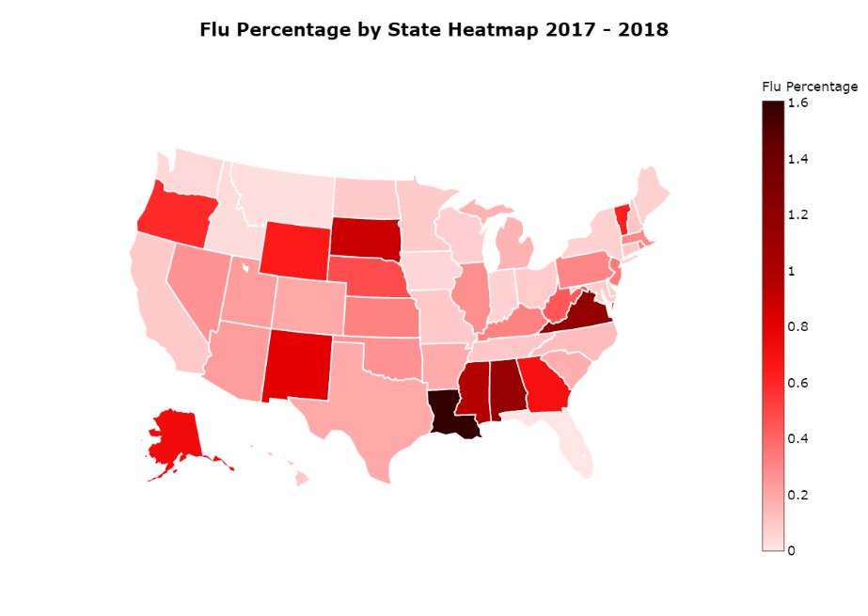
Vaccinations vs. Influenza
Outlier: Virginia
Notes:
2013-2014 date support the hypothesis in previous slide, higher the vaccination rate, lower the flu rate.
There also outliers in both years cases. For example, Virginia.
Possible reason: humidity, temperature

Slide 5

Vaccinations vs. Influenza
Virginia Flu Rate:
2013-2014: 0.81%
2017-2018: 1.17%
Alabama Flu Rate:
2013-2014: 0.29%
2017-2018: 1.13%
Louisiana Flu Rate:
2013-2014: 1.02%
2017-2018: 1.61%
Notes:
2017-2018 season has becoming an extremely serious flu-spreading year.
States that used to have high rate of influenza this years had a significant increase on number of reported cases.
Louisiana, Virginia, Alabama

